Slide 1

Introduction to MATLAB
File I/O
The MathWorks Inc.
Natick, MA
USA

Slide 2
Section Outline
File Input / Output
  High-level routines
  Import Wizard
  Low-level routines
Ref: File I/O Commands & Syntax
Notes:
Section Outline
File Input / Output
High-level routines
Import Wizard
Low-level routines
The high-level file I/O routines available within MATLAB provide for most of your data importing and exporting needs. The low-level file I/O routines provide an interface to accessing data from any file type, provided you know the format. The Import Wizard is our graphical interface for importing data from know file formats and regularly formatted ASCII text files.

Slide 3
File I/O : High-Level Routines
SAVE & LOAD
Other file formats (must contain only data matrix):
  CSVREAD - Comma-separated ASCII files
  DLMREAD - General ASCII delimited files
Use wildcard (*) for similar variables or file names
save fname
save fname x y z
save fname data*
save fname -ascii
save fname -mat
save fname -v4
load fname
load fname x y z
load fname data*
load fname -ascii
load fname -mat
>> help iofun
Ref: File I/O Commands & Syntax
Notes:
See:
Using MATLAB
Pages:
2-11-2-13
High-Level Routines
save and load
save
save fname
save fname x y z
save fname data*
save fname -ascii
save fname -mat
load
load fname
load fname x y z
load fname data*
load fname -ascii
load fname -mat
For most users, the MATLAB load and save functions provide sufficient means of loading and saving data. The load and save functions assume data is stored in a platform-independent binary data format with a file name ending in the .mat extension. These *.mat (or MATlab) files are platform-independent because they contain a machine signature in the file header. MATLAB checks the signature when it loads a file and, if a signature indicates that a file is foreign, performs the necessary conversion.
Use the MATLAB load and save routines to read and write both ASCII and binary data. These two commands are primarily for reading and writing full-precision binary MATLAB format files. It is also possible to read and write ASCII files with these routines. The save command creates space- or tab-delimited files of either 8- or 16- digit ASCII form. The load command reads any MAT-file created on any platform or any ASCII file with numeric space- or tab-delimited data.
Other file formats (must contain only data matrix):
xlsread - Microsoft Excel spreadsheet files
dlmread - General ASCII delimited files
Try:
>> help save
>> help load
>> help csvread
>> help dlmread

Slide 4
Example: High-Level Routines
>> clear all % Clear all variables
>> x = 5; x2 = 10; % Create x and x2
>> save xdata x % Save only x into xdata.mat
>> clear all % Clear all variables
>> load xdata % Load xdata.mat
>> whos % Note that x is back
Name Size Bytes Class
x 1x1 8 double array
Grand total is 1 elements using 8 bytes
>> x % Still equals 5
x =
5
>> x2 = 10; % Recreate x2
>> save xdata x* % Now save using a wild card
>> clear all % Clear all variables
>> load xdata % Load xdata.mat
>> whos % Both variables were saved
Name Size Bytes Class
x 1x1 8 double array
x2 1x1 8 double array
Grand total is 2 elements using 16 bytes
Notes:
High-Level Routines (Example)
>> clear all % Clear all variables
>> x = 5; x2 = 10;% Create x and x2
>> save xdata x % Save only x into
% xdata.mat
>> clear all % Clear all variables
>> load xdata % Load xdata.mat
>> whos % Note that x is back
Name Size Bytes Class
x 1x1 8 double array
Grand total is 1 elements using 8 bytes
>> x % Still equals 5
x =
5
>> x2 = 10; % Recreate x2
>> save xdata x* % Now save using a
% wild card
>> clear all % Clear all variables
>> load xdata % Load xdata.mat
>> whos % Both variables were saved
Name Size Bytes Class
x 1x1 8 double array
x2 1x1 8 double array
Grand total is 2 elements using 16 bytes

Slide 5
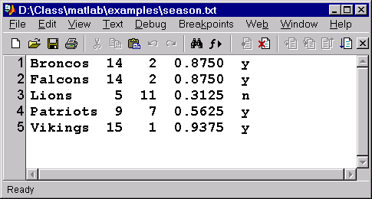
textread
Reads ASCII text files of uniform structure
Supports subset of formats for the C function fscanf
>> [team, w, l, wp, playoff] = textread('season.txt', '%s %d %d %f %c')
team =
'Broncos'
'Falcons'
'Lions'
'Patriots'
'Vikings'
w =
14
14
5
9
15
l =
2
...
Notes:
textread
Reads ASCII text files of uniform structure
Supports subset of formats for the C function fscanf
Syntax
[A,B,C, ...] = ...
TEXTREAD('FILENAME','FORMAT',N,...
param,value,)
Example
>> [t, w, l, wp, po] = ...
textread('season.txt','%s %d %d %f %c')
t =
'Broncos'
'Falcons'
'Lions'
'Patriots'
'Vikings'
w =
14
14
5
9
15
l =
2
...
Supported Conversion Specifications
%d - read a signed integer value (output is a double array)
%u - read a integer value (output is a double array)
%f - read a floating-point value (output is a double array)
%s - read a white space separated string (output is a cellstr)
%q - read a (possibly double quoted) string (output is a cellstr)
%c - read characters (including white space) (output is char array)
%[...] - read the longest string containing characters in the set
between the brackets (output is a cellstr)
%[^...] - read the longest nonempty string containing
characters not in the set between brackets (output is a cellstr)
Try:
>> help textread

Slide 6
importdata
>> s = importdata('train.wav')
s =
data: [12880x1 double]
fs: 8192
>> sound(data,fs)
IMPORTDATA can read text files, or binary files
It looks for helper functions to import that file type.
Notes:
importdata
>> s = importdata('train.wav')
s =
data: [12880x1 double]
fs: 8192
>> sound(s.data,s.fs)
importdata(FILENAME) loads data from FILENAME into the workspace. A = importdata(FILENAME) loads data from FILENAME into A.
importdata(FILENAME, D) loads data from FILENAME using D as the column separator (if text). Use '\t' for tab.
importdata looks at the file extension to determine which helper function to use.
If the extension is mentioned in fileformats, importdata
calls the appropriate helper function with the maximum number
of output arguments.
If the extension is not mentioned in fileformats,
importdata calls finfo to determine which helper function
to use.
If no helper function is defined for this extension, importdata
treats the file as delimited text. Empty outputs from the helper
function are removed from the result.
Refer to
>> help fileformats
Try:
>> help importdata
>> help fileformats
>> s = ...
importdata( ...
‘train.wav’)

Slide 7
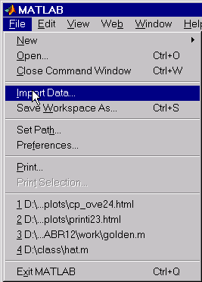
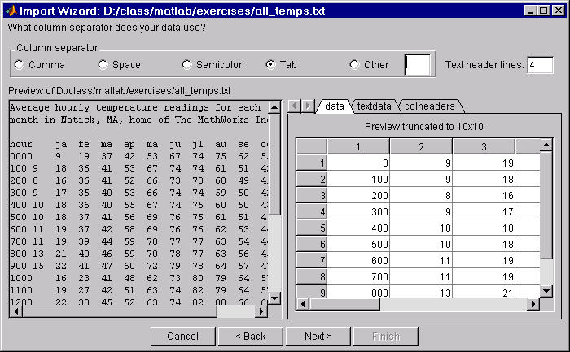
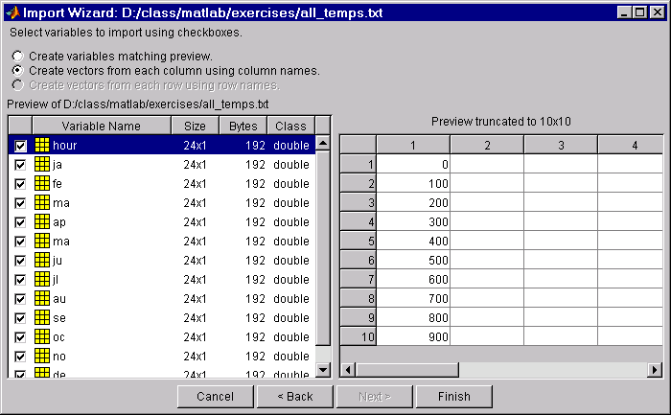
Import Wizard
>> uiimport
Notes:
Import Wizard
Try:
>> help uiimport
Index:
Import Wizard

Slide 8
Import Wizard with Text Data
>> uiimport
Notes:
Import Wizard
Using the Import Wizard with Text Data
1. Start the Import Wizard, by selecting the Import Data
option on the MATLAB File menu, or using the
uiimport function.
2. To import data from the clipboard, select the Paste
Special option on the MATLAB Edit menu, or right-click
in the MATLAB command window and choose Paste
Special from the context menu. Skip to the second part of Step 3
to continue importing from the clipboard.
3. Specify the file you want to import in the file selection dialog
box and click Open. The Import Wizard opens the file and
attempts to process its contents. Specify the character used to
separate the individual data items (the dlimiter/column-
separator). Once the Import Wizard has correctly processed the
data, click Next.
4. Select the variables that you want to import. By default, the
Import Wizard puts all the numeric data in one variable, and all
the text data in other variables, but you can choose other options.
5. Click Finish to import the data into the workspace.
Try:
>> help uiimport
Index:
Import Wizard

Slide 9
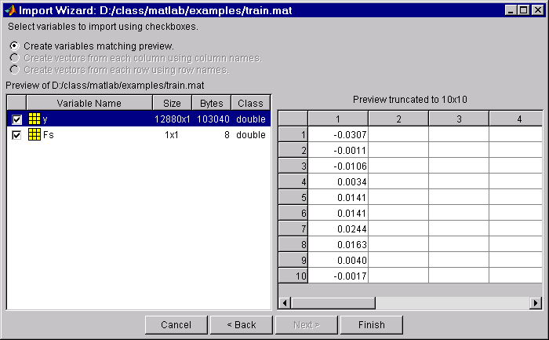
Import Wizard with Binary Data
>> uiimport
Notes:
Using the Import Wizard with
Binary Data
1. Start the Import Wizard, by selecting the Import Data
option on the MATLAB File menu, or use the uiimport
function. MATLAB displays a file selection dialog box.
2. To import data from the clipboard, select the Paste
Special option on the MATLAB Edit menu, right-click in the
MATLAB command window and choose Paste Special from the
context menu. Skip to the second part of Step 3 to continue
importing from the clipboard.
3. Specify the file you want to import in the file selection dialog
box and click Open. The Import Wizard opens the file and
attempts to process its contents.
4. Select the variables that you want to import. By default, the
Import Wizard creates variables depending on the type of data in
the file.
5. Click Finish to import the data into the workspace.

Slide 10

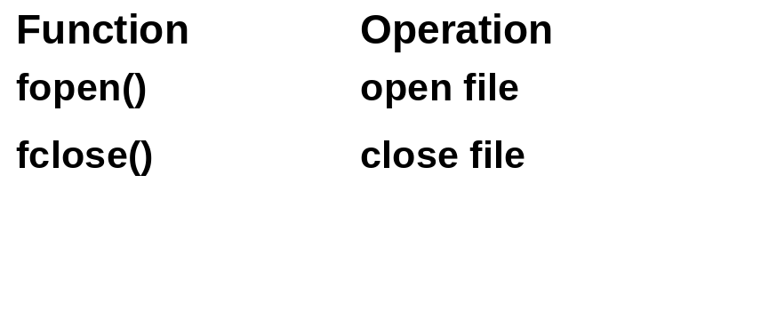
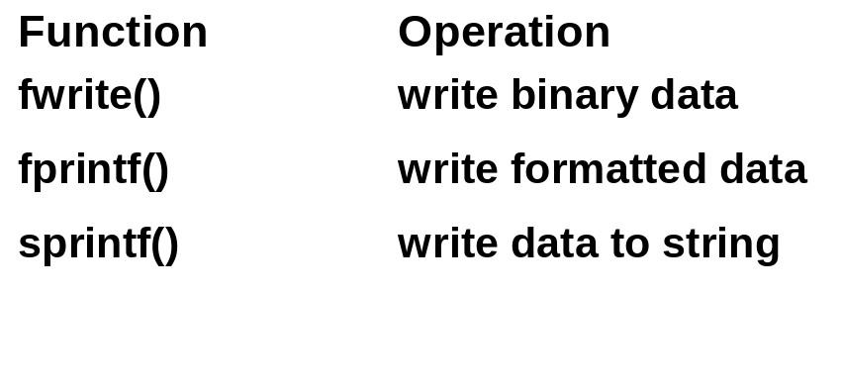
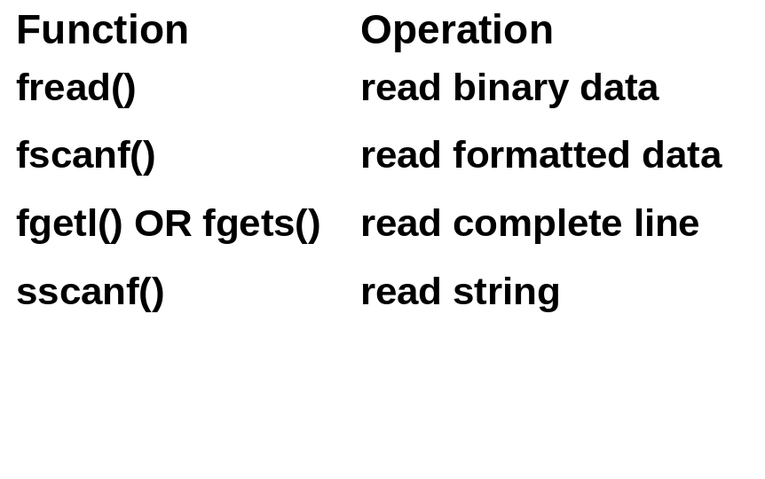
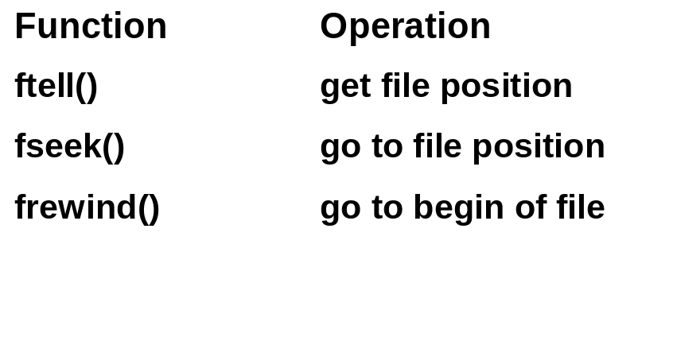
File I/O : Low-Level Routines
open/close:
write:
read:
position:
>> help iofun
Ref: File I/O Commands & Syntax
Notes:
See:
Using MATLAB
Pages:
Chapter 15
Low-Level Routines
General Procedure
1. Open the file and store the file identifier to a variable
>> fid = fopen('filename');
2. Perform the necessary file I/O:
For Binary files: fread/fwrite
For Text files: fscanf/fprintf/fgetl/etc.
3. Close the file:
>> fclose(fid);
Caution: Once a file is opened (fopen), it remains open until it is explicitly closed (fclose); even if execution is halted due to an error. This can cause problems when you try to start reading from or writing to the file again (e.g., the position is not reset to the beginning of the file). In severe cases it can also result in memory allocation problems, leaks, and memory corruption.
When doing file I/O from a script file this is not normally a problem, as long as you keep track of the file ID number. However, when doing file I/O from with a function, this can be very tricky because the file ID is not in the base workspace. To avoid running into problems you can set the Editor/Debugger to Stop If Error. This will give you access to the function’s workspace (and to the file ID) so you can close the file before continuing.
You can also execute fclose all to close all open files.
Try:
>> help iofun
% open/close
>> help fopen
>> help fclose
% binary data
>> help fread
>> help fwrite
% formatted data
>> help fscanf
>> help fgetl
>> help fprintf
% strings
>> help sscanf
>> help fgets
>> help sprintf
% position
>> help ftell
>> help fseek
>> help frewind

Slide 11
Supported File Formats:
Notes:
Readable File Formats
>> help fileformats
Readable file formats.
Text formats Command Returns
MAT - MATLAB workspace load Variables in file.
CSV - Comma separated numbers csvread Double array.
DLM - Delimited text dlmread Double array.
TAB - Tab separated text dlmread Double array.
Spreadsheet formats
XLS - Excel wksht xlsread Double array and cell array.
WK1 - Lotus 123 wksht wk1read Double array and cell array.
Movie formats Command Returns
AVI - Movie aviread MATLAB movie.
Image formats
JPEG - JPEG image imread MxNx3 truecolor image data.
TIFF - TIFF image imread MxNx3 truecolor image data.
GIF - GIF image imread Indexed data and colormap.
BMP - BMP image imread Indexed data and colormap.
PNG - PNG image imread MxNx3 truecolor image data.
HDF - HDF image imread MxNx3 truecolor image data.
PCX - PCX image imread Indexed data and colormap.
XWD - XWD image imread Indexed data and colormap.
Audio file formats
AU - NeXT/Sun sound auread Sound data and sample rate.
WAV - MS Wave sound wavread Sound data and sample rate.
See also IOFUN

Slide 12
Example: Low-Level Text File I/O
Writing data to text file:
>> fid = fopen('square_mat.txt', 'wt');
>> fprintf(fid, '%s\n', 'This is a square matrix');
>> fprintf(fid, '%i\t%i\t%i\n', [1 2 3; 4 5 6; 7 8 9]');
>> fclose(fid);
ASCII text file: square_mat.txt
This is a square matrix
1 2 3
4 5 6
7 8 9
>> fid=fopen('square_mat.txt', 'rt');
>> title = fgetl(fid);
>> [data,count]=fscanf(fid, '%i');
>> data = reshape(data, 3, 3);
>> data_transpose = data';
>> fclose(fid);
Reading data from text file:
>> fileio_ex
>> help fprintf
Notes:
See:
Using MATLAB
Pages:
15-13-15-17
Example:Low-Level Text File I/O
This example shows the procedure for creating, and then
reading a formatted text file.
Creating the Text File
>> fid = fopen('square_mat.txt', 'wt');
>> fprintf(fid, '%s\n', ...
'This is a square matrix');
>> fprintf(fid, '%i\t%i\t%i\n', ...
[1 2 3; 4 5 6; 7 8 9]');
>> fclose(fid);
1. Open the file to be written to in text mode ('wt') and store the
file ID in variable fid
2. Write the title to the file (fprintf)
3. Write the numeric data to the file (fprintf)
(Note: '%i' - denotes integers, '\t' - denotes tab character,
'\n' - denotes new line character.)
4. Close the file
ASCII text file square_mat.txt
This is a square matrix
1 2 3
4 5 6
7 8 9
Reading the Text File
>> fid=fopen('square_mat.txt', 'rt');
>> title = fgetl(fid);
>> [data,count]=fscanf(fid, '%i');
>> data = reshape(data, 3, 3);
>> data_transpose = data';
>> fclose(fid);
1. Open the file to read in text mode ('rt') and store the file ID
in variable fid
2. Read the title and discard new line character (fgetl)
3. Read all of the numeric data one integer at a time (fscanf)
4. Close the file
Try:
>> help fprintf
>> help fscanf
>> fileio_ex

Slide 13
Example: Low-Level Binary File I/O
Writing binary data to file:
>> fid = fopen('square_mat.bin','wb')
>> fwrite(fid, 'This is a square matrix', 'char');
>> fwrite(fid, [1 2 3; 4 5 6; 7 8 9]', 'int32');
>> fclose(fid);
Reading binary data from file:
>> fid = fopen('square_mat.bin','rb')
>> bintitle = fread(fid, 23, 'char');
>> title = char(bintitle')
title =
This is a squrare matrix
>> data = fread(fid, [3 inf], 'int32')
>> data_tranpose = data'
data_transpose =
1 2 3
4 5 6
7 8 9
>> fclose(fid)
fileio_ex2
help fread
Notes:
See:
Using MATLAB
Pages:
15-7-15-9
Low-Level Binary File I/O
This example shows the procedure for creating and then
reading a binary file.
Creating the Binary File
>> fid = fopen('square_mat.bin','wb')
>> fwrite(fid, ...
'This is a square matrix', 'char');
>> fwrite(fid, [1 2 3; 4 5 6; 7 8 9]', ...
'int32');
>> fclose(fid);
1. Open the file to be written to in binary mode ('wb') and store
the file ID in variable fid
2. Write the title to the file (fwrite)
3. Write the numeric data to the file (fwrite)
(Note: 'char' - denotes characters, 'int32' - denotes 32
bit integers.)
4. Close the file
Reading the Text File
>> fid = fopen('square_mat.bin','rb')
>> bintitle = fread(fid, 23, 'char');
>> title = char(bintitle')
title =
This is a squrare matrix
>> data = fread(fid, [3 inf], 'int32')
>> data_tranpose = data'
data_transpose =
1 2 3
4 5 6
7 8 9
>> fclose(fid)
1. Open the file to read in text mode ('rb') & store the file ID in
variable fid
2. Read the title and discard new line character (fread)
3. Read all of the numeric data one integer at a time (fread)
4. Close the file
Try:
>> help fread
>> help fwrite
>> fileio_ex2

Slide 14
Exercise 5.1: File I/O
Use File I/O functions to read in data.
Open and view the data file, "all_temps.txt"
Create a script file to
  Read in each header line (save the fourth header line)
  Read in the data as one matrix
Extra Credit
  Extract each column as a separate variable
  (use the strings from the saved header line as variable names)
  HINT: help eval
NOTE:
You can discard the first 3 header lines
Data matrix will be 24 rows x 13 columns
Notes:
Exercise 5.1: File I/O
Use file I/O functions to read in data.
Open and view the data file, all_temps.txt
Create a script file to:
Read in each header line (save the fourth header line).
Read in the data as one matrix.
Extra Credit
Extract each column as a separate variable.
(use the strings from the saved header line as variable names.)
Hint: >> help eval
Note: You can discard the first three header lines.
The data matrix will be 24 rows-by-13 columns.
Try:
>> edit all_temps.txt
>> help eval

Slide 15
Solution appears on following page.
Notes:
Solution appears on following page.

Slide 16
Solution 5.1: File I/O
fid = fopen('all_temps.txt', 'rt');
%Get the first three header lines
for i = 1:3
fgetl(fid);
end
headings = fgetl(fid); %Get month names
data = fscanf(fid, '%i', [13,24]); %Read in data
temps = data'; %Data must be transposed
%OR
%data = fscanf(fid, '%i'); %Read data as a vector
%temps = reshape(data, 13,24)' %RESHAPE the data
fclose(fid);
>> fileio_soln (uses: all_temps.txt)
Notes:
Solution 5.1: File I/O
fid = fopen('all_temps.txt', 'rt');
%Get the first three header lines
for i = 1:3
fgetl(fid);
end
%Get month names
headings = fgetl(fid);
%Read in data
data = fscanf(fid, '%i', [13,24]);
%Data must be transposed
temps = data';
%OR
%Read data as a vector
%data = fscanf(fid, '%i');
%RESHAPE the data
%temps = reshape(data, 13,24)'
fclose(fid);
Try:
>> edit fileio_soln
>> fileio_soln

Slide 17
Solution 5.1: File I/O (Extra Credit)
%Put the first column into a variable name "hour"
%The string "hour" is the first four elements of "headings"
eval([headings(1:4), ' = temps(:,1);'])
%Put each column into a variable that is named after
%the column heading. (Headings are two characters long.)
for i = 2:13
eval([headings((3*i):(3*i)+1), ' = temps(:,i);'])
end
fileio_soln (uses: all_temps.txt)
Notes:
Solution 5.1: File I/O
(Extra Credit)
%Put the first column into a variable
%name "hour”. The string "hour" is the
%first four elements of "headings"
eval([headings(1:4), ' = temps(:,1);'])
%Put each column into a variable that is
%named after the column heading. (Headings
%are two characters long.)
for i = 2:13
eval([headings((3*i):(3*i)+1), ...
' = temps(:,i);'])
end
Try:
>> edit fileio_soln
>> fileio_soln

Slide 18
Section Summary
File Input / Output
  High level routines
  Import Wizard
  Low level routines
Ref: File I/O Commands & Syntax
Notes:
Section Summary
File Input / Output
High-level routines
Import Wizard
Low-level routines

Slide 19
File I/O Commands & Syntax (1)
Notes:
File I/O Commands and Syntax
>> help iofun
File Opening and Closing.
fopen -Open file.
fclose - Close file.
Binary File I/O.
fread - Read binary data from file.
fwrite - Write binary data to file.
Formatted File I/O.
fscanf - Read formatted data from file.
fprintf - Write formatted data to file.
fgetl - Read line from file, discard newline character.
fgets - Read line from file, keep newline character.
input - Prompt for user input.
Note: This next section is not included in help iofun.
Formatted I/O Conversion Characters.
%d or %i - Integer
%u - Unsigned Integer
%o - Octal integer
%x - Hexadecimal integer
%f - floating point numbers {6 decimal places}
%e - floating point numbers (exponential format)
%g - floating point numbers (either f or e format)
%c - Single character
%s - Null-terminated character strings
String Conversion.
sprintf - Write formatted data to string.
sscanf - Read string under format control.
File Positioning.
ferror - Inquire file error status.
feof - Test for end-of-file.
fseek - Set file position indicator.
ftell - Get file position indicator.
frewind - Rewind file.

Slide 20
File I/O Commands & Syntax (2)
Notes:
File I/O Commands and Syntax
(Continued)
File Name Handling
matlabroot - Root directory of MATLAB installation.
filesep - Directory separator for this platform.
pathsep - Path separator for this platform.
mexext - MEX filename extension for this platform.
fullfile - Build full filename from parts.
partialpath - Partial pathnames.
tempdir - Get temporary directory.
tempname - Get temporary file.
File Import/Export Functions.
load - Load workspace from MAT-file.
save - Save workspace to MAT-file.
dlmread - Read ASCII delimited file.
dlmwrite - Write ASCII delimited file.
wk1read - Read spreadsheet (WK1) file.
wk1write - Write spreadsheet (WK1) file.
Image File Import/Export.
imread - Read image from graphics file.
imwrite - Write image to graphics file.
imfinfo - Return information about graphics file.
Audio File Import/Export.
auwrite - Write NeXT/SUN (.au) sound file.
auread - Read NeXT/SUN (.au) sound file.
wavwrite - Write Microsoft WAVE (.wav) sound file.
wavread - Read Microsoft WAVE (.wav) sound file.
Command Window I/O
clc - Clear command window.
home - Send cursor home.
disp - Display array.
input - Prompt for user input.
pause - Wait for user response.

